Slide 1




Slide 2
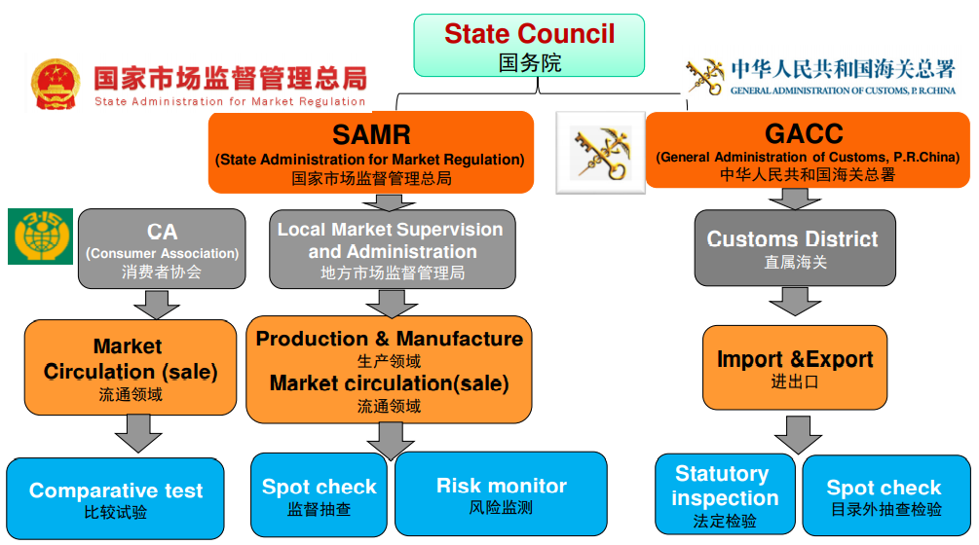

Product Compliance Surveillance System in China Market

Slide 3
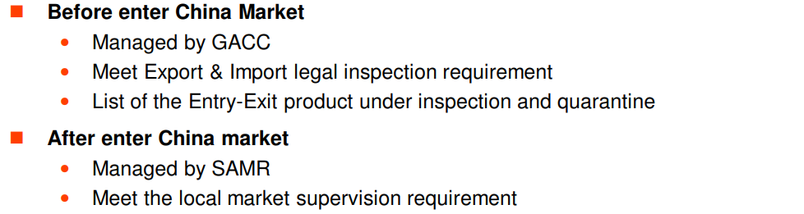

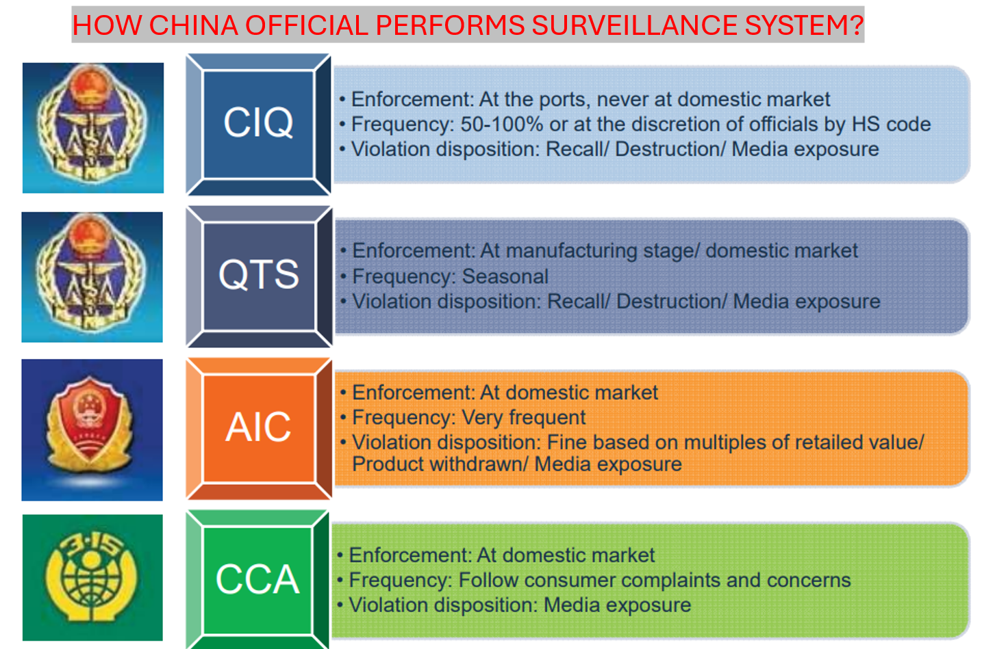




Slide 4

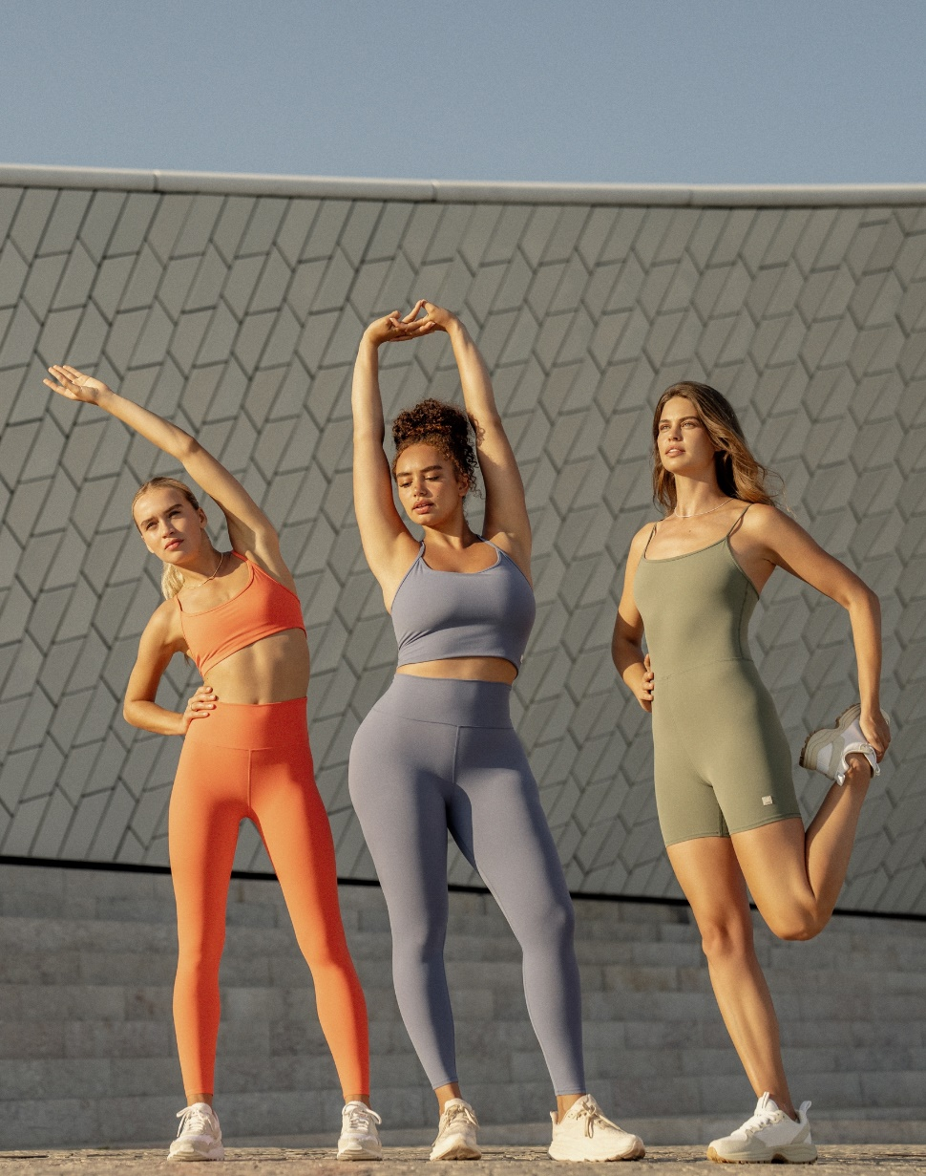
China Mandatory GB Standards for Softlines including Apparel:
GB 5296.4-2012 消费品使用说明 第4部分 纺织品和服装使用说明 Instructions for use of products of consumer interest – Part 4: Textiles and apparel
To comply with this standard, our product must have a permanently attached label which indicates proper instructions for use. Essential content required for our product's “Instructions for use” tag include:
The legally registered name and address of the manufacturer. For imported textiles and apparel, the country of origin should also be included.
Product name.
Product specification and apparel size designation, which should be permanently attached to the product in accordance with GB/T 1335.1.
Fiber content should also appear on a permanently attached label in accordance with FZ/T 01053.
Care instructions (permanently attached) in accordance with GB/T 8685.
Product standard code: the applicable national or industry standard against which our product was tested, which can be attached to the product's packaging or to the product in the form of a hanging tag.
Product quality classification: based on the requirements specified by the applied standard.

Slide 5
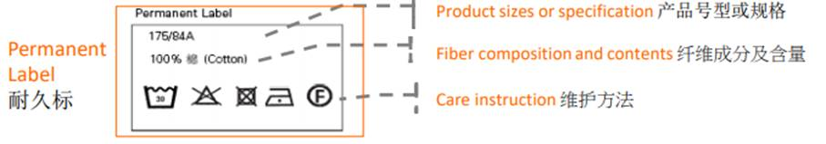
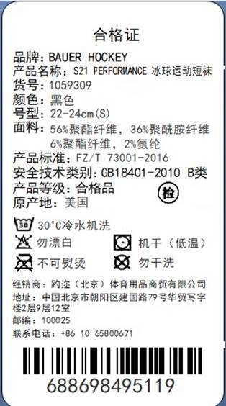
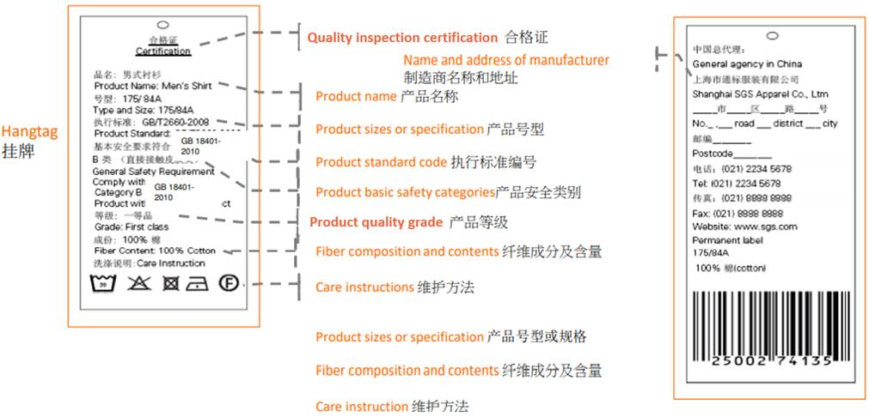
GB 5296.4 Instructions for Use of products of consumer interest – Part 4: Textiles and apparel
Template of “Permanent Label” and “Hangtag” as follows, these are required:
Garment
Textile
Garment
Textile

Slide 6
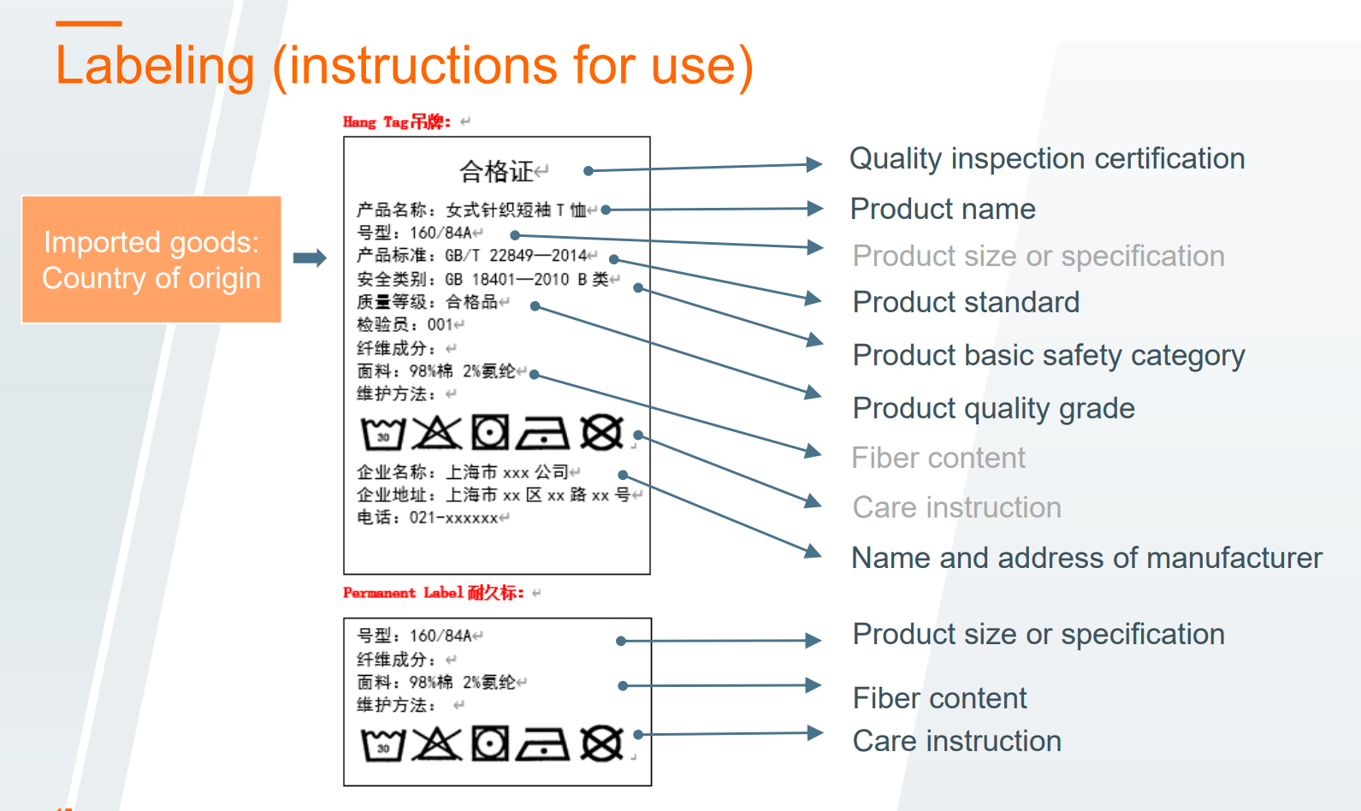
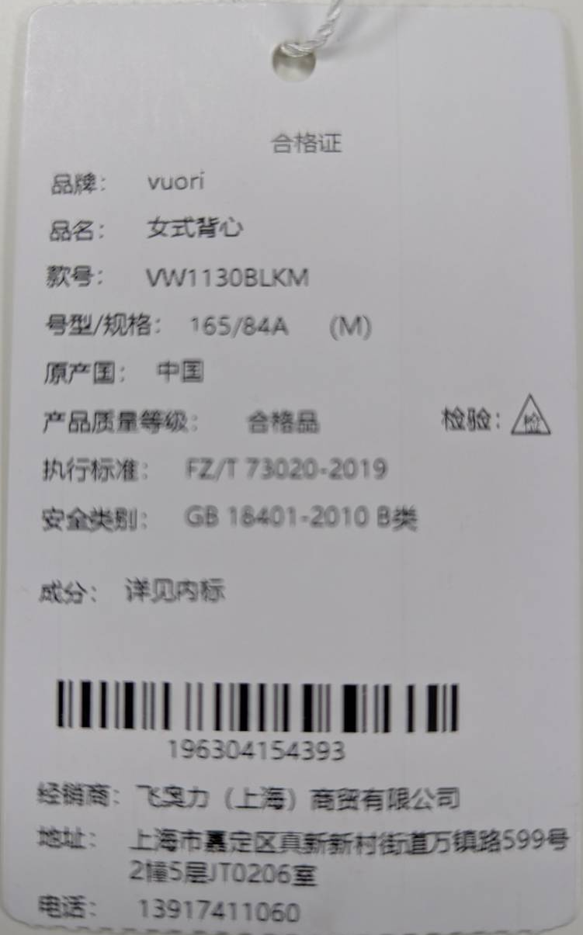


Current Vuori Hang Tag
Garment
Textile

Slide 7
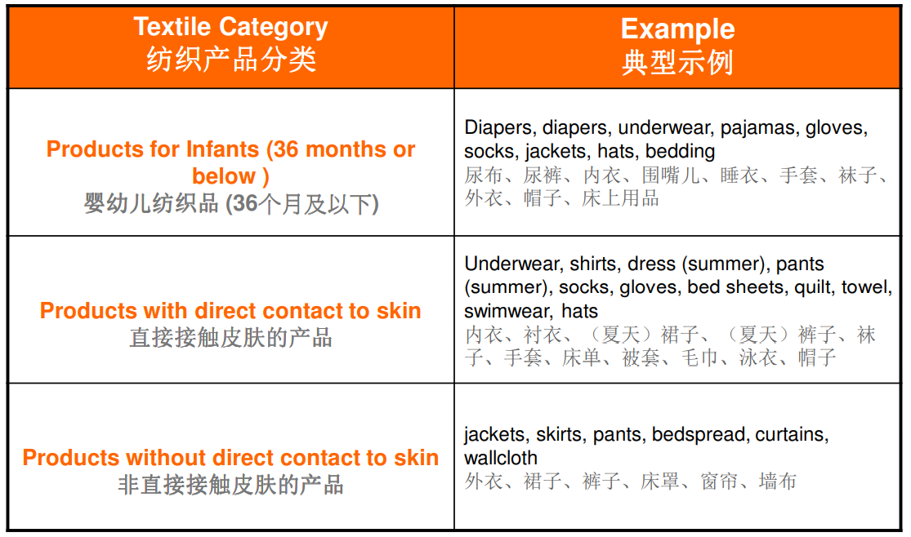
GB 18401-2010 国家纺织产品基本安全技术规范 National general safety technical code for textile products

Slide 8
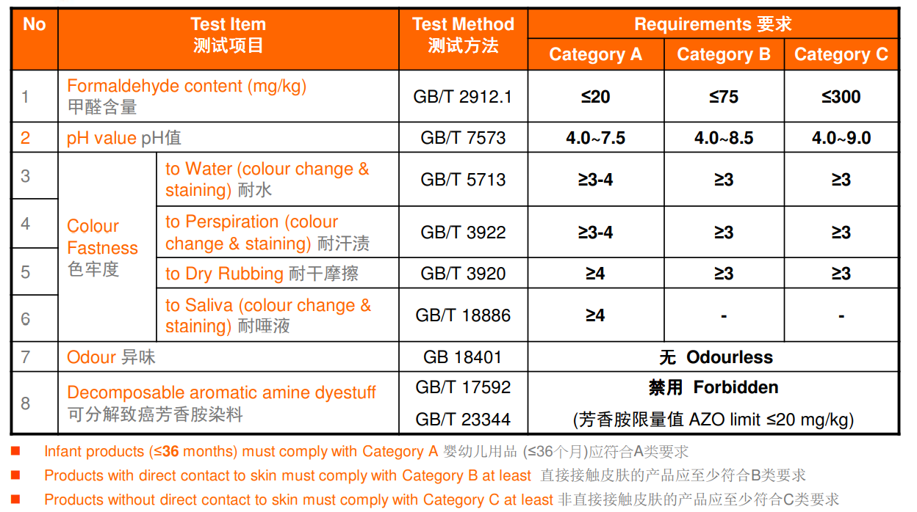




GB 18401-2010 国家纺织产品基本安全技术规范 National general safety technical code for textile products

Slide 9
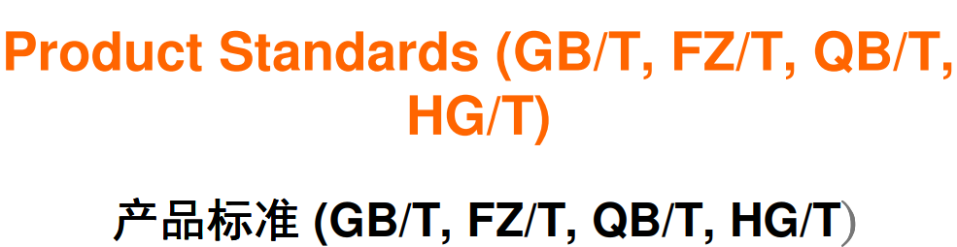

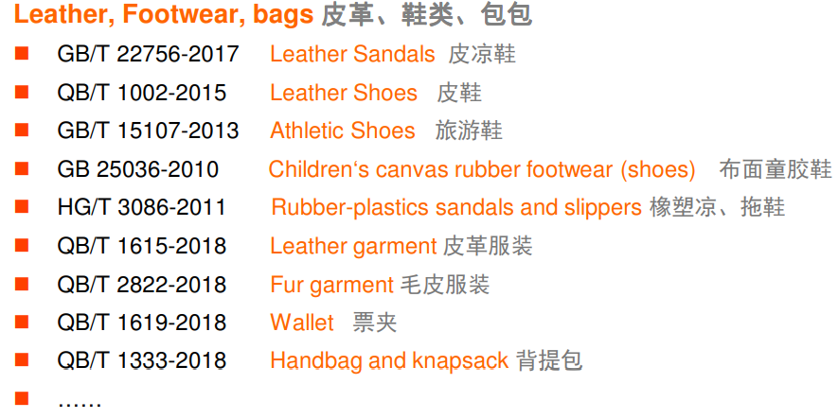
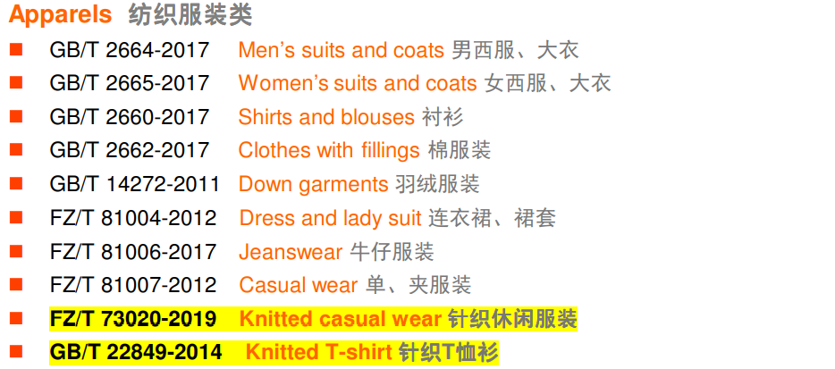
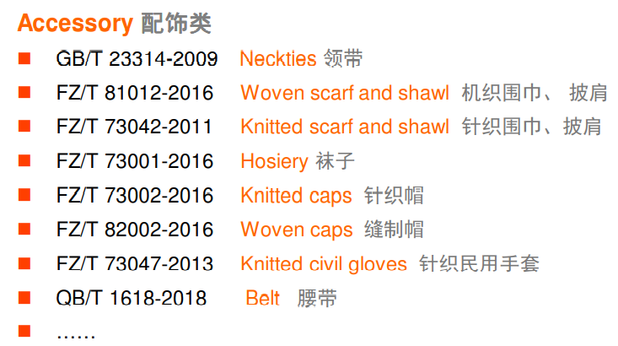







Slide 10
GB/T 29868-2020 (newer version) 针织专业运动服装通用技术要求 is for Sports protective products-Knitted products general technical requirements
GB/T 21980-2017 专业运动服装和防护用品通用技术规范 is for General technical specification for sportswear and protecting suits
More instances:
GB/T 32614-2016 for Outdoor sportswear-water resistant garments
GB/T 22849-2014 Knitted T-shirt
GB/T 2664-2017 for Men's suits and coats
FZ/T 81008-2011 for Jackets
FZ/T 73020-2012 for Knitted casual wear
QBT 2155-2010 Travelling case and trolley bag
ETC-----
For being able to tell which GB Product Standards applied - Need to know:
The material composition of apparels such as Fiber Content ?% of Polyester, Nylon, Spandex, etc---
The weaving construction of apparels such as Knitted or Woven
The designed usage of apparels such as Man, Women and Children
The performance of apparels such as Water Resistance/Water Repellency, etc----
There are over 700 kinds of Product Standard in China now~~~

Slide 11

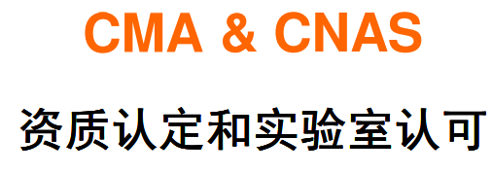


Must provide each classification of at least one CNAS & CMA Quality Report from the qualified Lab. with authority issued by China Officials.

Slide 12
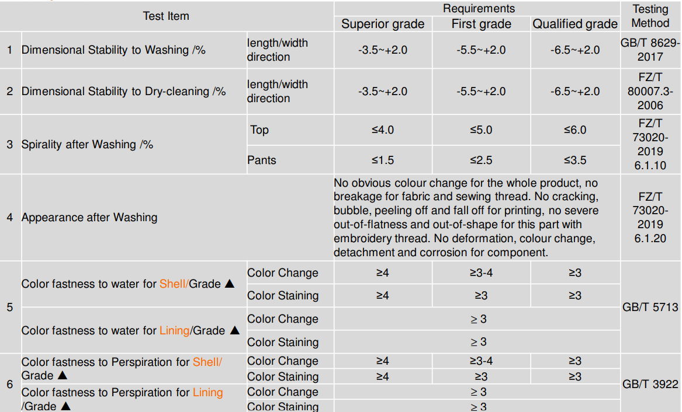
EX: FZ/T 73020 – 2019 Knitted Casual Wear

Slide 13
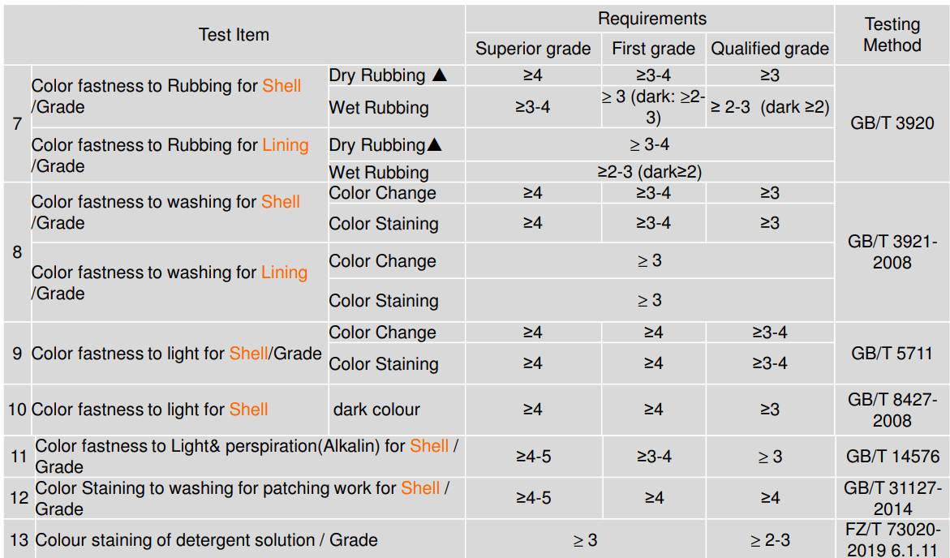

Slide 14
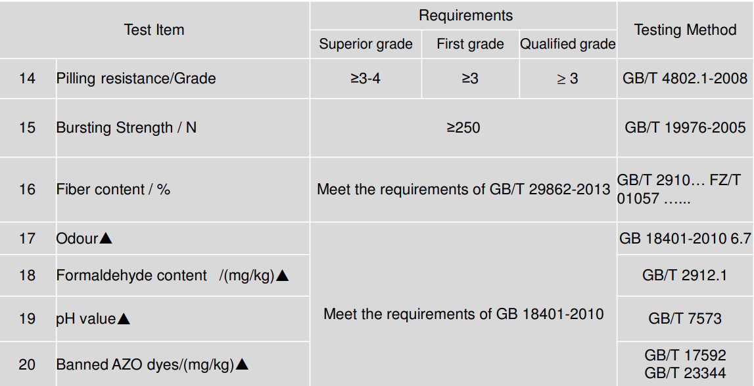

Slide 15
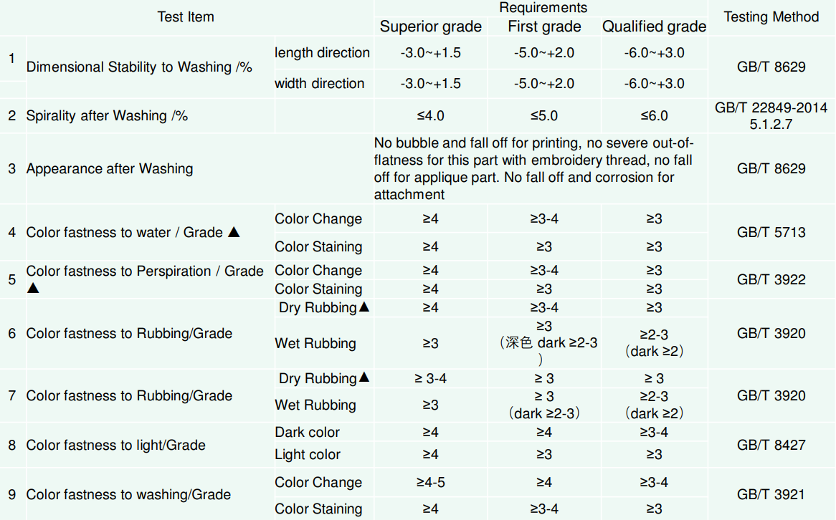
EX: GB/T 22849 – 2014 Knitted T-shirt

Slide 16
